Slide 1
PROSTHETIC HEART VALVES
Dr.Santhosh Narayanan
SR cardiology

Slide 2
Topic outline
Types of prosthetic heart valves
Complications of prosthetic valves
Functional assessment of normal and dysfunctional prosthetic valves
Valve specific approach
Issues in anticoagulation

Slide 3
How to approach increased prosthetic valve gradient
Physiological vs Pathological regurgitation
Prosthetic valve thrombosis and stuck valve
Thrombus vs Pannus
Dilemmas in anticoagulation

Slide 4
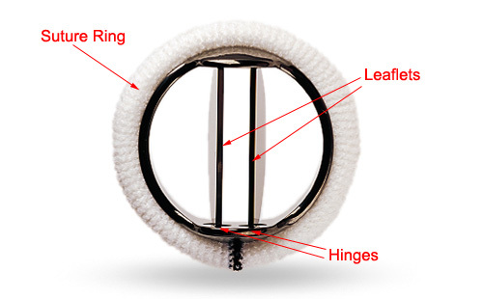
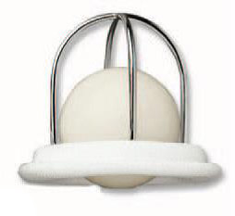
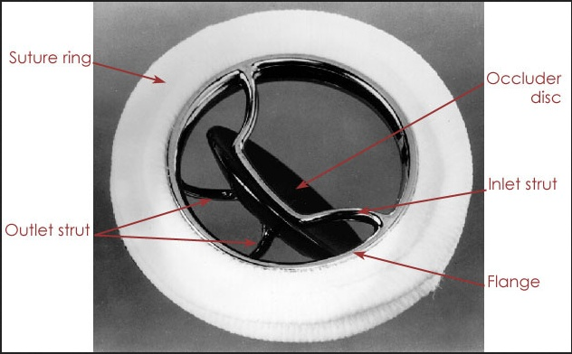
PROSTHETIC HEART VALVES- Types
MECHANICAL PROSTHETIC VALVES
Ball & cage
Tilting disc
Bileaflet valve

Slide 5
PROSTHESIS MATERIALS
Housing and occluder
Pyrolytic carbon on graphite
Silicone rubber
Titanium,cobalt chromium alloy

Slide 6
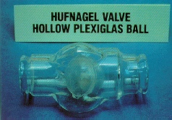
History of prosthetic valves
1954

Slide 7
Acrylic ball
Plexiglass methaacrylate
For AR
Prevented regurgitation only from lower part of body
Frequent embolisation
Disconcerting Noise
CHARLES HUFNAGEL

Slide 8
Harken soroff ball valve(Double cage)

Slide 9
Harken's commandments for an ideal prosthetic valve
1.Must not propogate emboli
2.Chemically inert,does n't damage blood elements
3.No resistance to physiological flows
4.Must close promptly(less than 0.05 second)
5.Must remain closed during appropriate phase of cardiac cycle
6.Durability -long term
7.Less noise
8.Must be able to insert in a physiological site(normally anatomical)
9.Sterilisation and storage
DWIGHT HARKEN

Slide 10
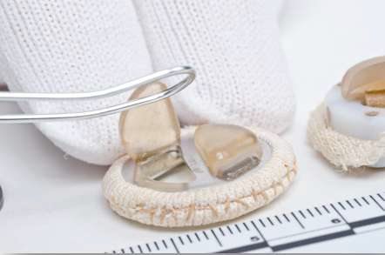
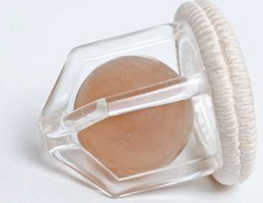
STARR EDWARDS valve-The evolution

Slide 11
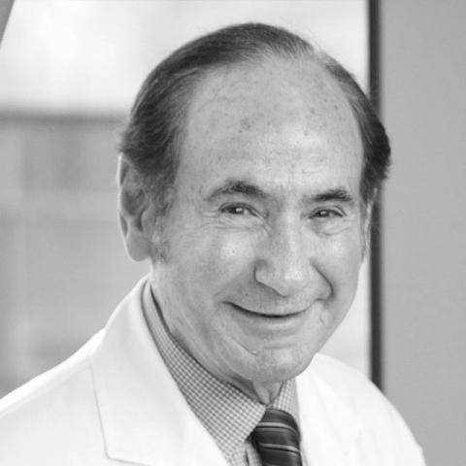
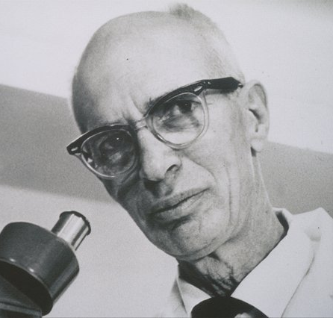
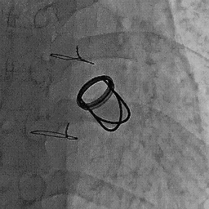
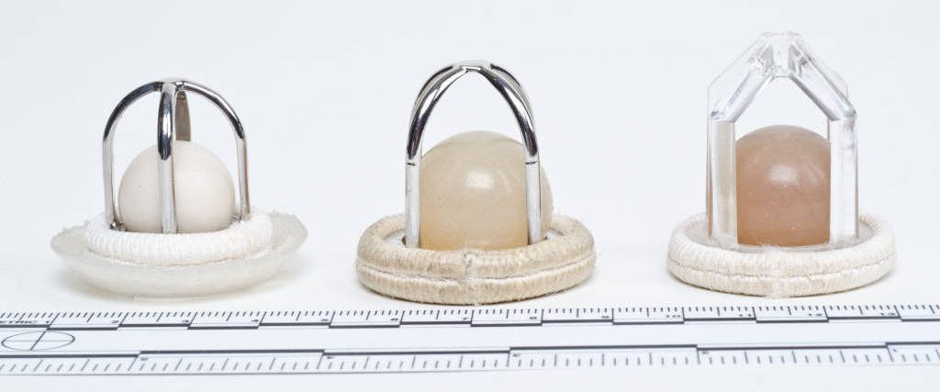
STARR -EDWARDS valve
1960

Slide 12
1960 - Philip Admundson - 2nd Patient in whom SEP valve was implanted.Lived for 15 years post surgery

Slide 13
Ball and cage valve- Working principle
Ball will be forced to one side of the valve or the other depending on which way blood is flowing
Modelled after ball valves used in industrial applications to allow the flow of fluids in one direction
Pressure exerted by the proximal chamber onto the blood (and the ball) exceeds the pressure in the distal chamber ball is pushed away open position of the valve
Pressure inside the proximal chamber falls Negative pressure draws the ball valve backwards

Slide 14
SEP for aortic valve
Aortic valve that resulted in a large pressure drop with
increased resistance to forward flow
The four struts were replaced by three struts of reduced thickness, made of an exceptionally hard alloy, Stellite
Sewing ring shaped to conform tightly to the high pressure flow across the aortic valve

Slide 15
Modifications of Starr Edwards Prosthesis
Magovern- Cromie
Smeloff - Cutter
DeBakey - Surgitool
Braunwald Cutter

Slide 17
Short-Comings of Ball and Cage
Bulky in design, doesn't fit well into a small ventricle or aorta
Small internal orifice, relatively stenotic
Non physiological(non central) flow,collision with blood elements- hemolysis
Thrombogenic

Slide 19
Cage and disc valves

Slide 20
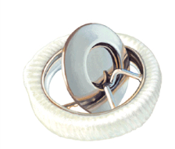
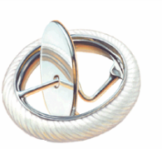
Tilting disc valve
Tilting occluder disc
Mimic natural flow patterns (more central flow)
Reduces thrombosis,infection,hemolysis
-BUT DOESN'T ELIMINATE THEM
BJORK SHILEY VALVE(1971)
MEDTRONIK HALL-PIVOTING DISC

Slide 21
Single disk prosthesis
Round sewing ring and a circular disk fixed eccentrically to the ring via a hinge.
Disk moves through an arc of less than 90º allows:
Antegrade flow in the open position
Seating within the sewing ring to prevent backflow in the closed position.
MAJOR DRAWBACK -STRUT FRACTURE(BJORK SHILEY)

Slide 22
CHITRA VALVE(TTK CHITHRA)

Slide 23
CHITRA VALVE advantages
Complete structural integrity
Rotatable within the sewing ring to assure its freedom to rotate if repositioning needed.
Low profile, most price-friendly
Low thromboembolism rates

Slide 24
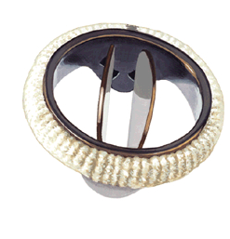
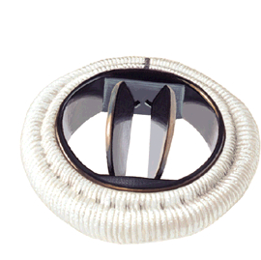
Bileaflet mechanical valves
Opening angle is generally more vertical (approx 80º) than single disk prosthesis
Results in three distinct orifices:
Two larger ones on either side and a smaller central rectangular-shaped orifice.
St. Jude
Carbomedics

Slide 25
Bileaflet valves

Slide 26
Flow Profile - Bileaflet
Complex fluid dynamics
Open position
Two large lateral valve orifices with a small narrow central “slitlike” orifice
Three peak velocities corresponding to three orifices
Highest velocity in middle orifice
Local gradients are often substantially higher than overall valvular pressure
Closed position
Two criss cross jets of regurgitation are seen in plane parallel to the leaflet opening plane

Slide 27
Bileaflet valve-St.Jude

Slide 28
Carbomedics valve

Slide 29
Bileaflet valves advantages over single disc
Carbon leaflets and flange exhibit high strength and excellent biocompatibility
Largest opening angle
Low turbulence.
Low bulk and flat profile
Easier insertion
Superior hemodynamics
Lower transvalvular pressure gradient
Less Thrombogenic

Slide 30
VALVE | HOUSING | OCCLUDER
Starr-Edwards | Three (aortic) or four-strut (mitral) cobalt-chrome alloy cage | Silicone rubber
Bjork–Shiley | Cobalt-chrome alloy | Silicon alloyed pyrolytic carbon on graphite substrate
Medtronic-Hall | Titanium alloy | Silicon alloyed pyrolytic carbon on tungsten-loaded graphite substrate
St Jude Medical | Pyrolytic carbon over graphite substrate with metallic band | Silicon alloyed pyrolytic carbon on tungsten-loaded graphite substrate

Slide 31
Bioprosthetic valves
Autograft
Homograft
Heterograft
Stented
Stentless
Porcine
Porcine
Bovine

Slide 32
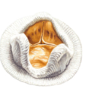
Stented Porcine valves
Pig’s aortic valve is placed on stents, attached to a sewing ring and glutaraldehyde stabilized
Hancock I and II
Carpentier-Edwards perimount
St.Jude epic
Hancock Porcine

Slide 33
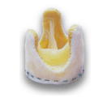
Stentless Porcine Valve
A low-pressure glutaraldehyde fixed intact porcine valve supported by Dacron cloth
Advantage: No stents allows larger valve to be implanted
Two approved valves:
Toronto SPV
Freestyle Valve
Toronto SPV

Slide 34
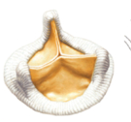
Bovine Pericardial valve
Bovine pericardium fashioned into a trileaflet valve
Mounted on stents and a sewing ring
Carpentier-Edwards
Ionescu- Shiley (Withdrawn)
Mitroflow
Carpentier Edwards – Valve

Slide 36
Sutureless stented porcine valve

Slide 37
Valves for TAVI

Slide 38
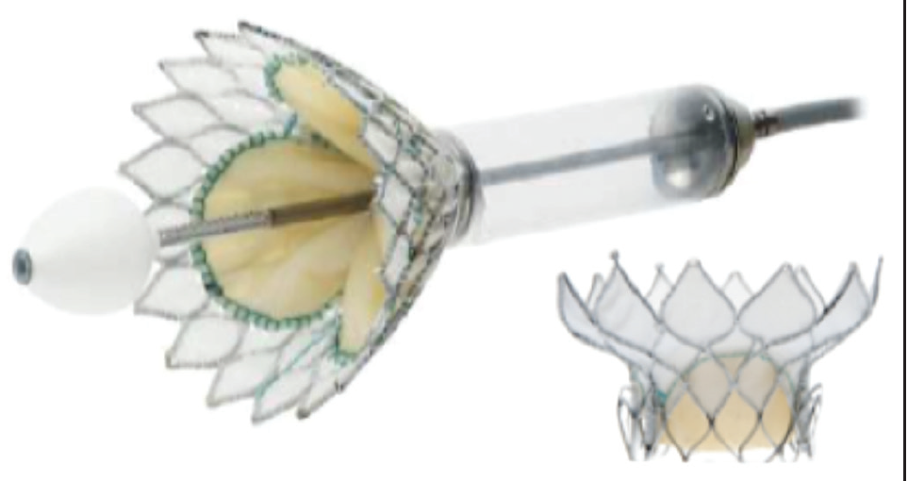
Transcatheter mitral valve

Slide 39
Evolution

Slide 44
Complications of prosthetic valves
1.Structural valve deterioration(Changes intrinsic to valve)
2.Non structural dysfunction (Extrinsic)
3.Valve thrombosis and embolism
4.Infective endocarditis
5.Bleeding event

Slide 45
Structural valve deterioration
Mechanical valve
Bioprosthetic valve
1.Ball variance
2.Poppet escape
3.Strut fracture
4.Fabric wear and tear
1.Calcification
2.Leaflet tear
3.Stent creep

Slide 46
Non structural valve dysfunction
Any abnormality not intrinsic to the valve that results in stenosis or regurgitation of the valve or haemolysis
(1) Entrapment/Obstruction by pannus,thrombus, or suture
(2) Paravalvular leak
(3) Inappropriate sizing or positioning -"PPM"
(4) Residual leak or obstruction after valve implantation
(5) Clinically important intravascular haemolysis,hyperkalemia
(6) Dilatation of aorta or aortic annulus causing aortic regurgitation (for stentless valves)
(7) Pseudoaneurysm

Slide 47
Other definitions
STUCK VALVE -dysfunctional mechanical prosthesis in which at least 1 leaflet loses its free movement and is “stuck” in either an open or closed position
VALVE DEHISCENCE- Displacement from the implanted position resulting in "rocking motion"
(Sewing ring around prosthesis becomes unsecured to surrounding structures)

Slide 48
Endocarditis and sequelae
Infection of the replacement heart valve
-Vegetation
-Pus
-Abscess
proven by 1.Surgical evidence at reoperation
2.At Autopsy
3.Positive Duke's criteria

Slide 49
Mechanisms of Degeneration of bioprosthetic valve

Slide 50
Functional Assessment of prosthetic valves
Clinical examination
Imaging
- CXR
- TTE
- TEE
- 3D ECHO,STRESS ECHO
- FLOUROSCOPY,CATH
- MDCT
- MRI

Slide 51
Clinical examination

Slide 54
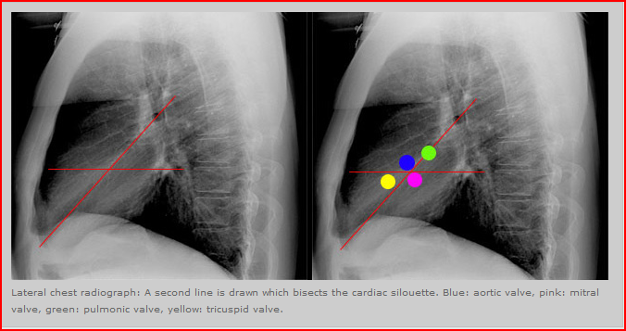
Chest xray

Slide 56
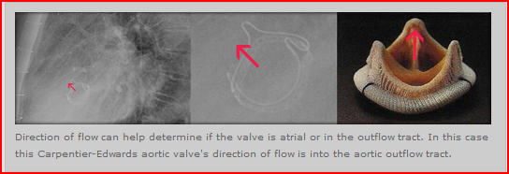
Determination of site of valve by direction of flow
If the direction of flow is from
Inferior to superior – likely aortic valve.
Superior to inferior- likely a mitral valve.

Slide 57
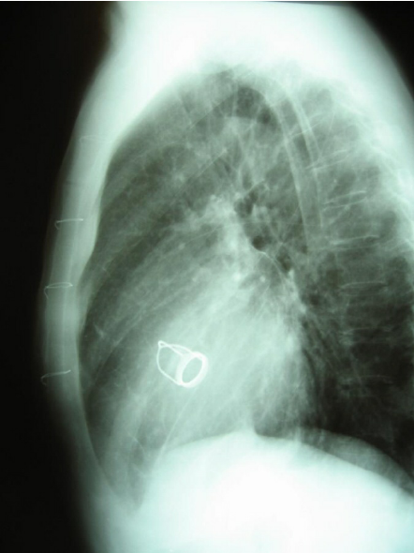
Direction of flow

Slide 60
Identify the valve

Slide 65
Four prosthetic st.jude valves

Slide 66
CINEFLOUROSCOPY
Structural integrity
Motion of the disc or poppet
Excessive tilt of the base ring - valve dehiscence
A rocking motion of greater than 15⁰ of sewing-ring excursion is abnormal
Aortic valve prosthesis - RAO caudal
- LAO cranial
Mitral valve prosthesis - RAO cranial

Slide 67
Opening angle and closing angle -Carbomedics Bileaflet valve

Slide 69
Normal Opening and closing angles

Slide 71
Opening angle increased in obstruction

Slide 72
St.jude bileaflet valve

Slide 75
BALL AND CAGE VALVE

Slide 82
THANK YOU

